Slide 1
Trees
Binary Trees
Binary Search Trees

Slide 2
Theory and Terminology
Definition: A tree is a connected graph with no cycles
Consequences:
  Between any two vertices, there is exactly one unique path

Slide 3
Theory and Terminology
Definition: A rooted tree is a graph G such that:
  G is connected
  G has no cycles
  G has exactly one vertex called the root of the tree

Slide 4
Theory and Terminology
Consequences
  The depth of a vertex v is the length of the unique path from root to v
  G can be arranged so that the root is at the top, its neighboring vertices are vertices of depth 1, and so on…
  The set of all vertices of depth k is called level k of the tree

Slide 5
A Rooted Tree
depth = 0
root
1
depth = 1
2
3
4
depth = 2
5
6
7
8
depth = 3
9
10
11
12

Slide 6
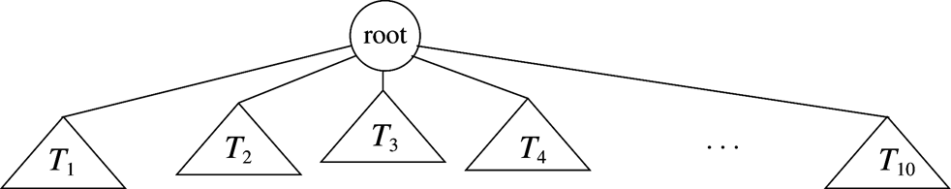
Rooted Tree: Recursive definition
A graph with N nodes and N - 1 edges
Graph has
  one root r
  Zero or more non-empty sub-trees, each of whose root is connected to r by an edge.
  Every node except the root has one parent

Slide 7
Theory and Terminology
Definition: A descending path in a rooted tree is a path, whose edges go from a vertex to a deeper vertex
depth = 0
root
1
depth = 1
2
3
4
3
depth = 2
5
6
7
8
8
depth = 3
9
10
11
12
12

Slide 8
Theory and Terminology
Consequences:
  A unique path from the root to any vertex is a descending path
  The length of this path is the depth of the vertex
depth = 0
1
root
1
depth = 1
2
3
3
4
depth = 2
5
6
7
8
8
depth = 3
9
10
11
11
12

Slide 9
Theory and Terminology
Definition: If there is a descending path from v₁ to v₂, v₁ is an ancestor of v₂, and v₂ is a descendant of v₁.

Slide 10
Theory and Terminology
Suppose v is a vertex of depth k:
  Any vertex that is adjacent to v must have depth k - 1 or k + 1.
depth = 0
1
root
1
depth = 1
2
3
3
4
depth = 2
5
6
7
8
7
8
depth = 3
9
10
11
12

Slide 11
Theory and Terminology
Suppose v is a vertex of depth k:
  Vertices adjacent to v of depth k + 1 are called children of v.
depth = 0
root
1
depth = 1
2
3
3
4
depth = 2
5
6
7
8
7
8
depth = 3
9
10
11
12

Slide 12
Theory and Terminology
Suppose v is a vertex of depth k:
  If k > 0, there is exactly one vertex of depth k – 1 that is adjacent to v in the graph.
  This vertex is called the parent of v.
depth = 0
1
root
1
depth = 1
2
3
3
4
depth = 2
5
6
7
8
depth = 3
9
10
11
12

Slide 13
Theory and Terminology
Definitions
  A vertex with no children is called a leaf
depth = 0
root
1
depth = 1
2
3
4
depth = 2
5
6
7
8
depth = 3
9
10
11
12

Slide 14
Theory and Terminology
Definitions
  Depth of a vertex v is its distance from the root.
  Height of a vertex v is the distance of the longest path from v to one of its descendant leaves.
  The height of a tree is the maximum depth of its vertices
depth = 0
root
1
depth = 1
2
3
4
height
depth = 2
5
6
7
8
depth = 3
9
10
11
12

Slide 15
Theory and Terminology
Definitions
  The root is the only vertex of depth 0. The root has no parent.
depth = 0
1
root
1
depth = 1
2
3
4
depth = 2
5
6
7
8
depth = 3
9
10
11
12

Slide 16
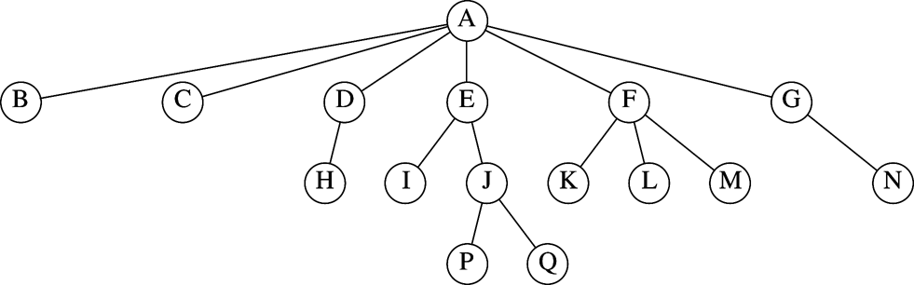
Example of rooted tree
Which are the parent nodes?
Which are the child nodes?
Which are the leaves?
What is the height and depth of the tree?
What is the height and depth of node E? Node F?

Slide 17
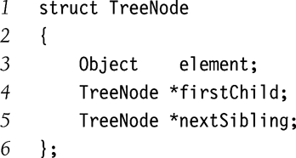
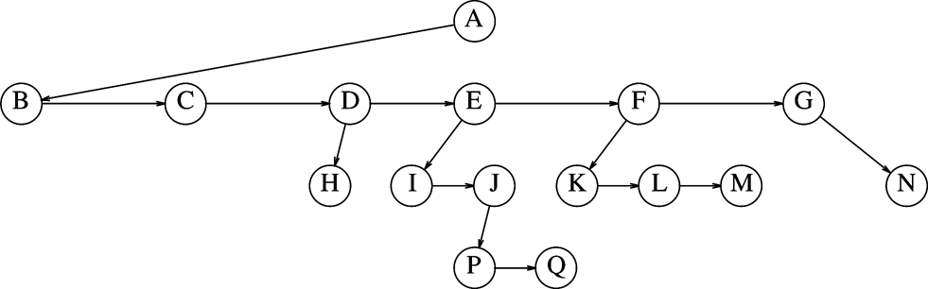
Overview of Tree Implementation
Each node points to
  Its first child
  Its next sibling
  Back to its parent (optional)
What could be an alternate representation?

Slide 18
Tree Traversals
Definition: A traversal is the process for “visiting” each node in a tree once
  Often defined recursively
  Each kind corresponds to an iterator type
  Iterators are implemented non-recursively

Slide 19
Preorder Traversal
Visit each node before recursively visiting its children, left to right.
Depth-first search
  Begin at root
  Visit node on arrival
Implementation may be recursive, stack-based, or nested loop

Slide 20
Preorder Traversal
root
1
2
3
4
2
3
4
5
6
7
8
5
6
7
8

Slide 21
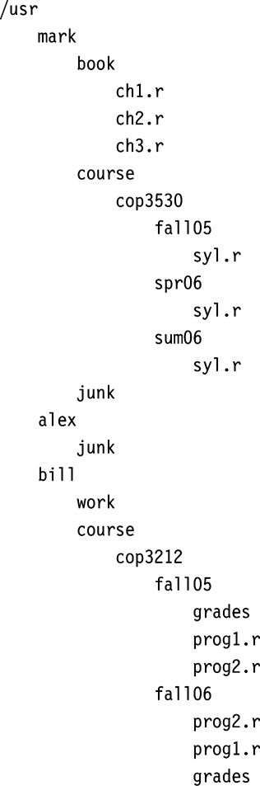
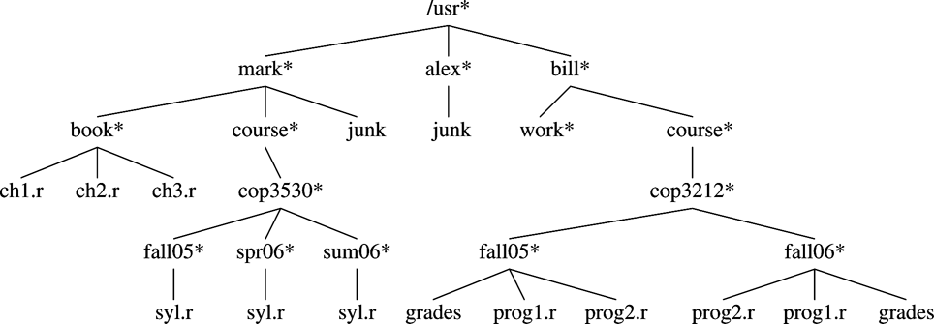
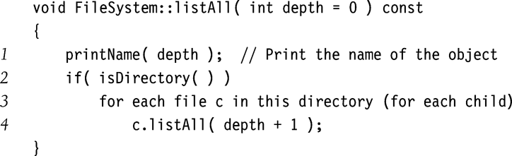
Preorder Traversal of UNIX Directory Tree

Slide 22
Postorder Traversal
Visit each node’s children (left-to-right) before the node itself.
Depth-first search
  Begin at root
  Visit node on departure
Implementation may be recursive, stack-based, or nested loop

Slide 23
Postorder Traversal
root
1
1
2
2
2
3
3
3
4
4
4
5
5
5
6
6
6
7
7
7
8
8
8

Slide 24
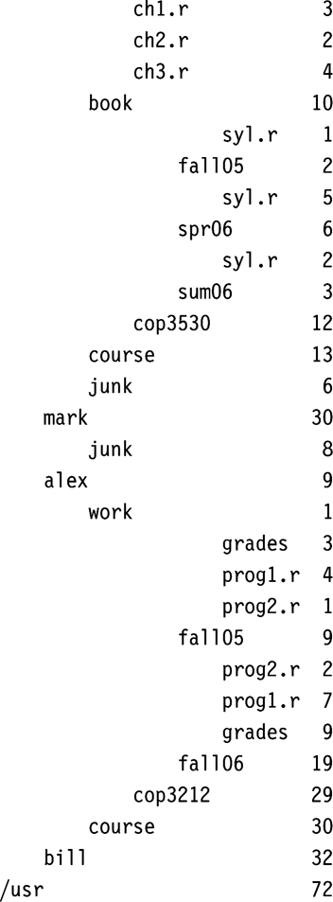

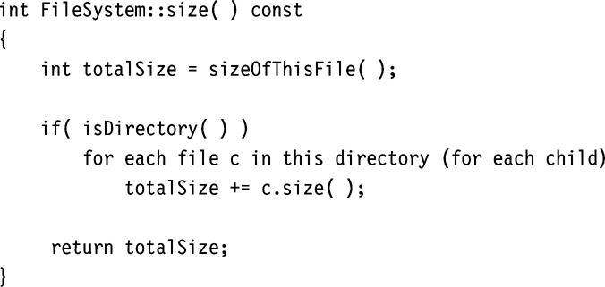
Postorder Traversal
Calculating Size of Directory

Slide 25
Levelorder Traversal
Visit all vertices in level, starting with level 0 and increasing
Breadth-first search
  Begin at root
  Visit vertex on departure
Only practical implementation is queue-based

Slide 26
Levelorder Traversal
root
1
1
2
2
2
3
3
3
4
4
4
5
5
5
6
6
6
7
7
7
8
8
8

Slide 27
Tree Traversals
Preorder: depth-first search (possibly stack-based), visit on arrival
Postorder: depth-first search (possibly stack-based), visit on departure
Levelorder: breadth-first search (queue-based), visit on departure

Slide 28
Binary Trees

Slide 29
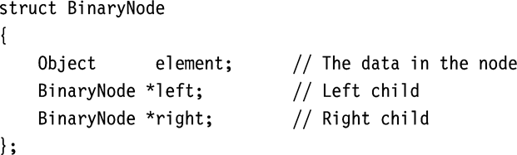
Binary Trees
Definition: A binary tree is a rooted tree in which no vertex has more than two children
root
1
2
3
4
5
6
7

Slide 30
Binary Tree Traversals
Inorder traversal
  Definition: left child, visit, right child (recursive)
  Algorithm: depth-first search (visit between children)

Slide 31
Inorder traversal
root
1
1
3
3
2
3
2
2
4
4
4
5
5
5
6
6
6
7
7
7

Slide 32
Binary Tree Traversals
Other traversals apply to binary case:
  Preorder traversal
    vertex, left subtree, right subtree
  Inorder traversal
    left subtree, vertex, right subtree
  Postorder traversal
    left subtree, right subtree, vertex
  Levelorder traversal
    vertex, left children, right children

Slide 33
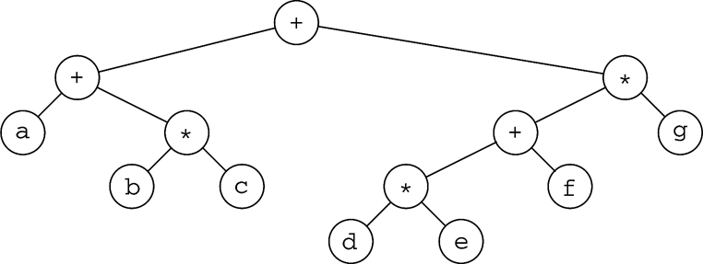
Example: Expression Tree
How do you construct an expression tree
from a postfix expression?
E.g a b + c d e + * *

Slide 34
Full Binary Trees
A binary tree is a full binary tree if and only if:
  Each non leaf node has exactly two child nodes
  All leaf nodes have identical path length
It is called full since all possible node slots are occupied

Slide 35
Complete Binary Trees
A complete binary tree (of height h) satisfies the following conditions:
  Level 0 to h-1 represent a full binary tree of height h-1
  One or more nodes in level h-1 may have 0, or 1 child nodes
  If j,k are nodes in level h-1, then j has more child nodes than k if and only if j is to the left of k

Slide 36
Binary Trees
Theorem: In a complete binary tree with n vertices and height H
  2^{H} ≤ n < 2^{H + 1}

Slide 37
Binary Trees
Proof:
  At level k ≤ H-1, there are 2^{k} vertices
  At level k = H, there are at most 2^{H} vertices
  Total number of vertices:
    n = 2⁰ + 2¹ + …2^{k}
    n = 1 + 2¹ + 2² +…2^{k} (Geometric Progression)
    n = (2^{k + 1} – 1) / (2-1)
    n = 2^{k + 1} - 1

Slide 38
Binary Trees
Let k = H
  n = 2^{H + 1} – 1
  n < 2^{H + 1}
Let k = H – 1
  n’ = 2^{H} – 1
  n ≥ n’ + 1 = 2^{H}
2^{H} ≤ n < 2^{H + 1}

Slide 39
Vector Representation of Complete Binary Tree
Tree data
  Vector elements carry data
Tree structure
  Vector indices carry tree structure
  Index order = levelorder
  Tree structure is implicit
  Uses integer arithmetic for tree navigation

Slide 40
Vector Representation of Complete Binary Tree
Tree navigation
  Parent of v[k] = v[(k – 1)/2]
  Left child of v[k] = v[2*k + 1]
  Right child of v[k] = v[2*k + 2]
root
0
l
r
ll
lr
rl
rr

Slide 41
Vector Representation of Complete Binary Tree
Tree navigation
  Parent of v[k] = v[(k – 1)/2]
  Left child of v[k] = v[2*k + 1]
  Right child of v[k] = v[2*k + 2]
0 | 1 | 2 | 3 | 4 | 5 | 6
0

Slide 42
Vector Representation of Complete Binary Tree
Tree navigation
  Parent of v[k] = v[(k – 1)/2]
  Left child of v[k] = v[2*k + 1]
  Right child of v[k] = v[2*k + 2]
0 | 1 | 2 | 3 | 4 | 5 | 6
0 | l

Slide 43
Vector Representation of Complete Binary Tree
Tree navigation
  Parent of v[k] = v[(k – 1)/2]
  Left child of v[k] = v[2*k + 1]
  Right child of v[k] = v[2*k + 2]
0 | 1 | 2 | 3 | 4 | 5 | 6
0 | l | r

Slide 44
Vector Representation of Complete Binary Tree
Tree navigation
  Parent of v[k] = v[(k – 1)/2]
  Left child of v[k] = v[2*k + 1]
  Right child of v[k] = v[2*k + 2]
0 | 1 | 2 | 3 | 4 | 5 | 6
0 | l | r | ll

Slide 45
Vector Representation of Complete Binary Tree
Tree navigation
  Parent of v[k] = v[(k – 1)/2]
  Left child of v[k] = v[2*k + 1]
  Right child of v[k] = v[2*k + 2]
0 | 1 | 2 | 3 | 4 | 5 | 6
0 | l | r | ll | lr

Slide 46
Vector Representation of Complete Binary Tree
Tree navigation
  Parent of v[k] = v[(k – 1)/2]
  Left child of v[k] = v[2*k + 1]
  Right child of v[k] = v[2*k + 2]
0 | 1 | 2 | 3 | 4 | 5 | 6
0 | l | r | ll | lr | rl

Slide 47
Vector Representation of Complete Binary Tree
Tree navigation
  Parent of v[k] = v[(k – 1)/2]
  Left child of v[k] = v[2*k + 1]
  Right child of v[k] = v[2*k + 2]
0 | 1 | 2 | 3 | 4 | 5 | 6
0 | l | r | ll | lr | rl | rr

Slide 48
Binary Search Trees
Notes:
Introduction
Welcome to COP 4530, Data Structures, Algorithms, and Generic Programming. I hope very much, and sincerely believe, that this course will change you in ways that are deeply satisfying. So far, you have acquired proficiency in programming. This course will start the process of your transformation from a programmer to a computer scientist. One of the important tasks of a computer scientist is to make efficient use of computational resources. This course will teach you about different ways of organizing the data to facilitate such efficient use, and will also discuss efficient techniques to perform some fundamental operations in computer science. A subsequent course on Algorithms, COP 4531, will teach you to use the techniques discussed in this course to solve commonly encountered computer science problems efficiently. Both these courses will also teach you to analyze the efficiency, and prove the correctness, of your program in a mathematically rigorous manner. Material you learn in these two courses is critical to your becoming a good software developer later.

Slide 49
Binary Search Tree
Also known as Totally Ordered Tree
Definition: A binary tree B is called a binary search tree iff:
  There is an order relation ≤ defined for the vertices of B
  For any vertex v, and any descendant u of v.left, u ≤ v
  For any vertex v, and any descendent w of v.right, v ≤ w

Slide 50
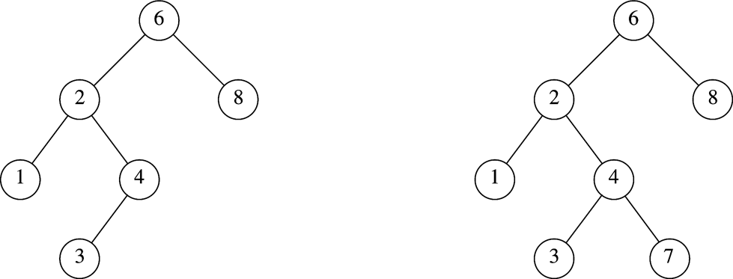
Binary Search Tree
Which one is NOT a BST?

Slide 51
Binary Search Tree
Consequences:
  The smallest element in a binary search tree (BST) is the “left-most” node
  The largest element in a BST is the “right-most” node
  Inorder traversal of a BST encounters nodes in increasing order
root
4
2
6
1
3
5
7

Slide 52
Binary Search using BST
Assumes nodes are organized in a totally ordered binary tree
  Begin at root node
  Descend using comparison to make left/right decision
    if (search_value < node_value)
    “go to the left child”
    else if (search_value > node_value)
    “go to the right child”
    else return true // success
  Until descending move is impossible
  Return false (failure)

Slide 53
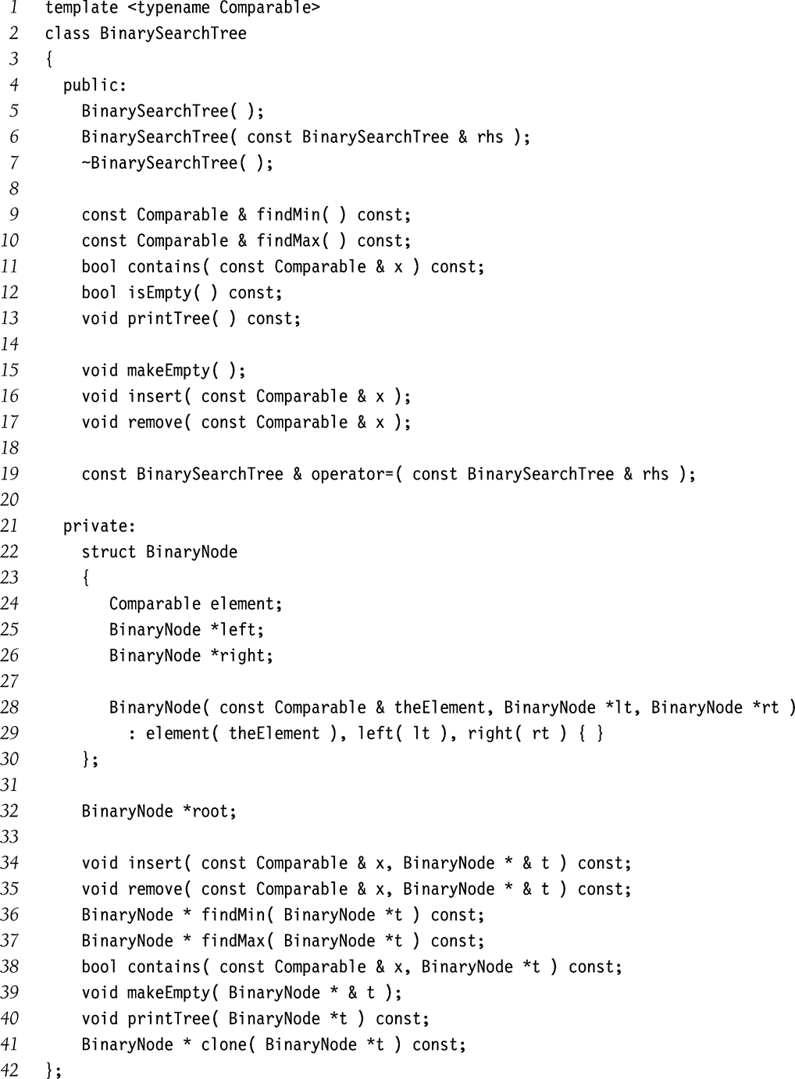
BST Class Template

Slide 54
BST Class Template (contd.)
Pointer passed by reference
(why?)
Internal functions
used in recursive
calls

Slide 55
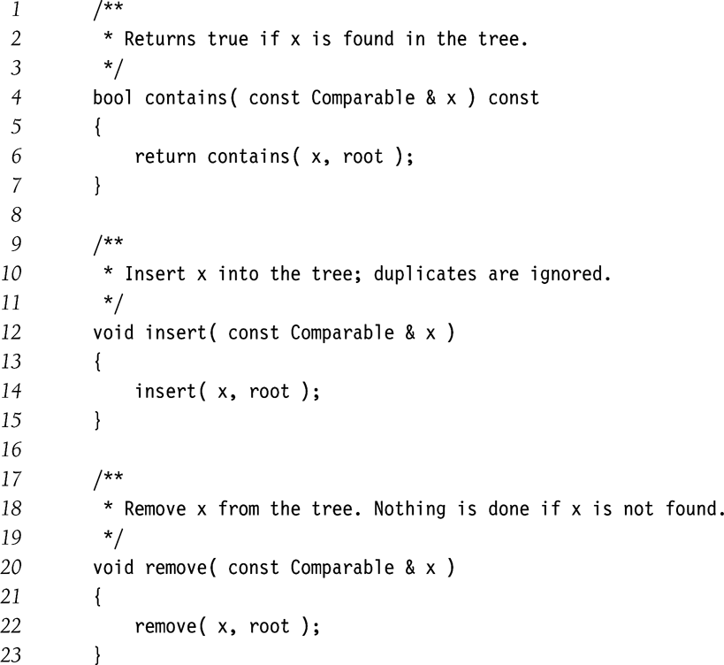
BST: Public members calling private recursive functions

Slide 56
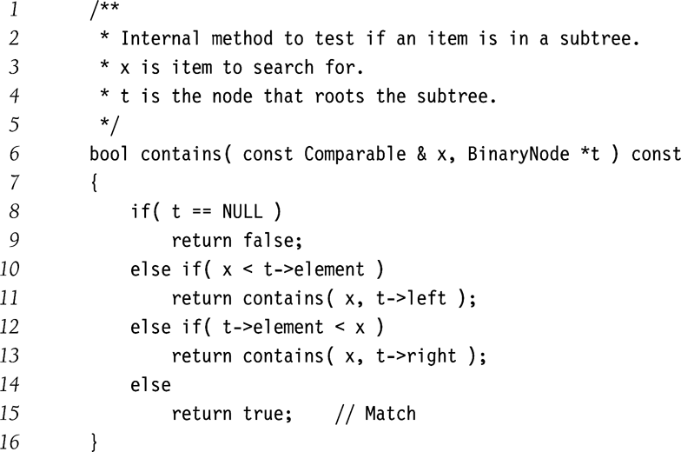
BST: Searching for an element

Slide 57
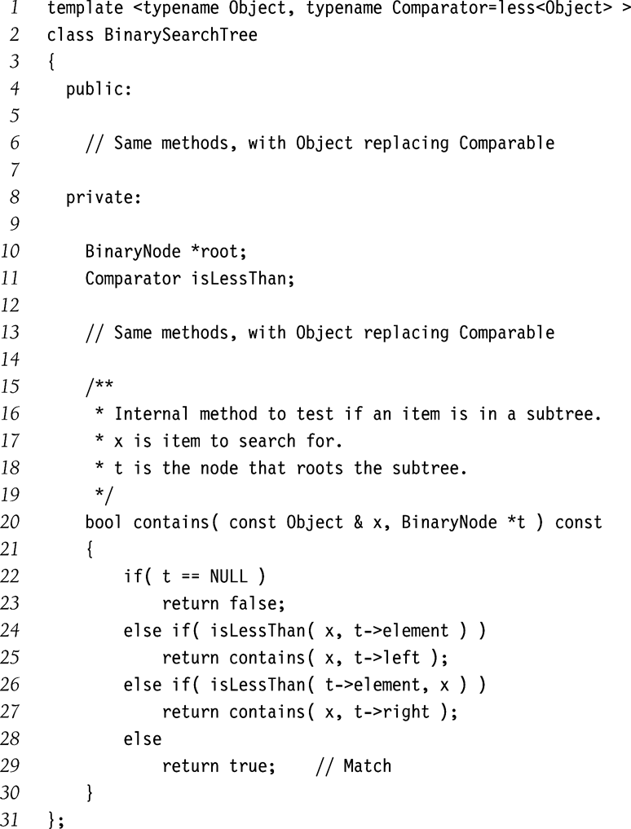
BST: Search using function objects

Slide 58
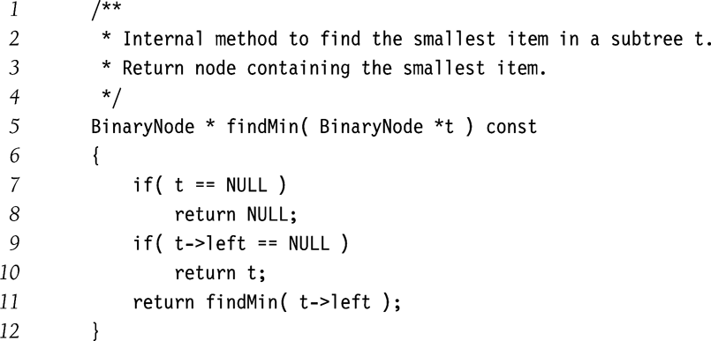
BST: Find the smallest element
Tail recursion

Slide 59
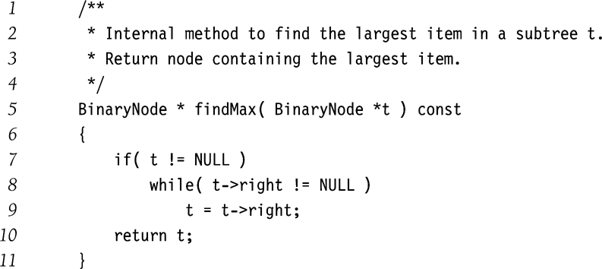
BST: Find the biggest element
Non-recursive

Slide 60
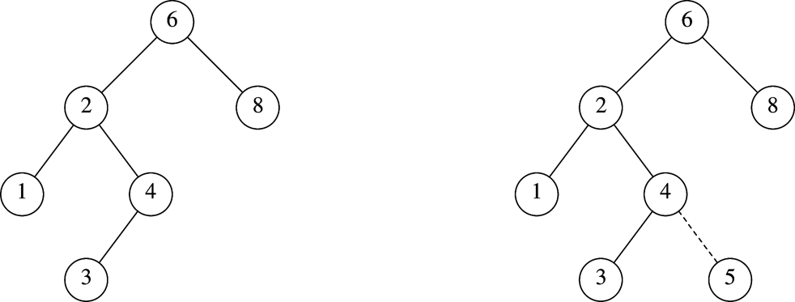
BST: Insertion
Before insertion
After insertion

Slide 61
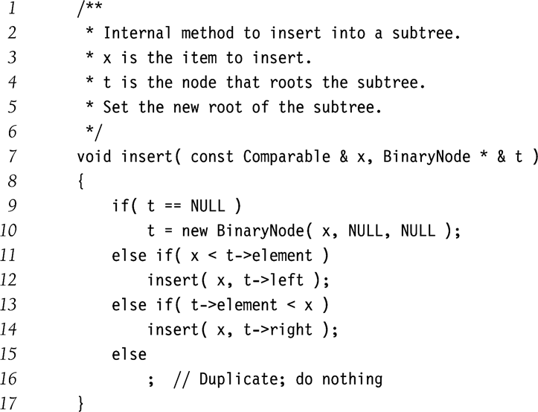
BST: Insertion (contd.)
Strategy:
Traverse the tree as in searching for t with contains()
Insert if you cannot find the element t.

Slide 62
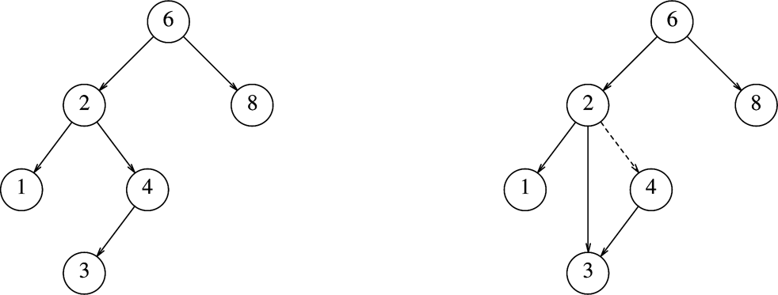
BST: Deletion
Deleting a node with one child
Before delete(4)
After delete(4)
Deletion Strategy: Bypass the node being deleted

Slide 63
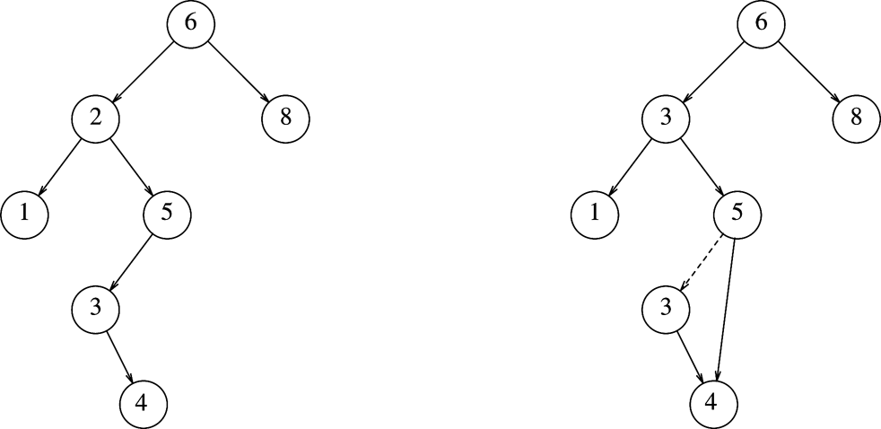
BST: Deletion (contd.)
Deleting a node with two children
After delete(2)
Before delete(2)
Deletion Strategy: Replace the node with
smallest node in the right subtree

Slide 64
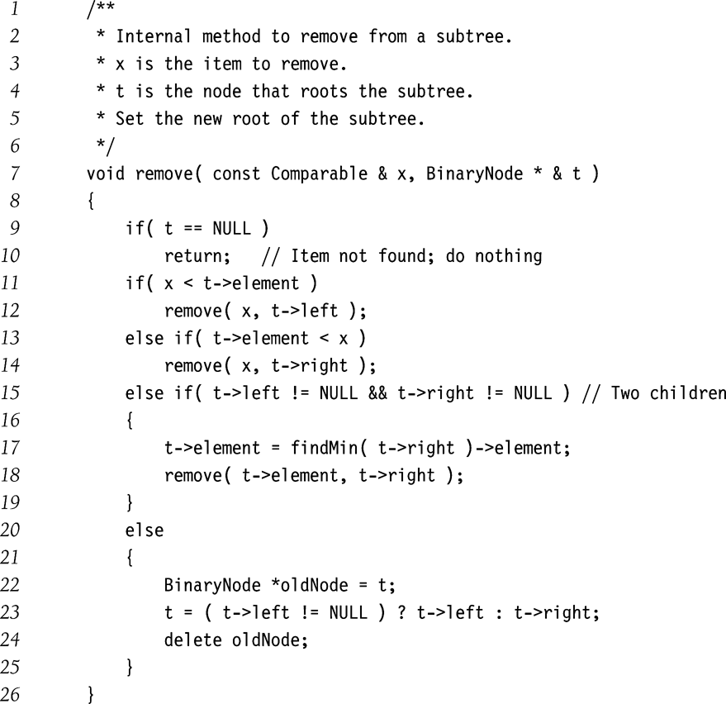
BST: Deletion (contd.)

Slide 65
BST: Lazy Deletion
Another deletion strategy
  Don’t delete!
  Just mark the node as deleted.
  Wastes space
  But useful if deletions are rare or space is not a concern.

Slide 66
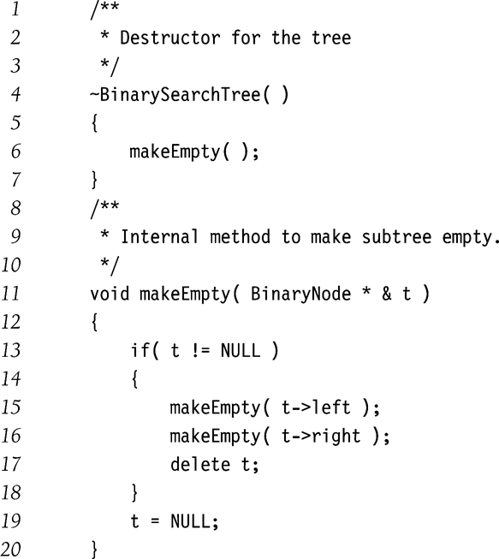
BST: Destructor

Slide 67
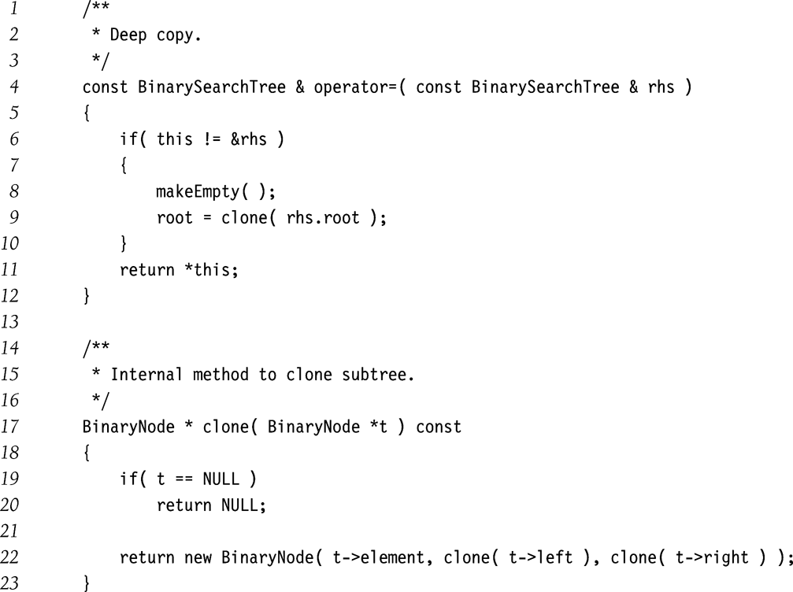
BST: Assignment Operator

Slide 68
BST: Insertion Bias
Start with an empty tree.
Insert elements in sorted order
What tree do you get?
How do you fix it?

Slide 69
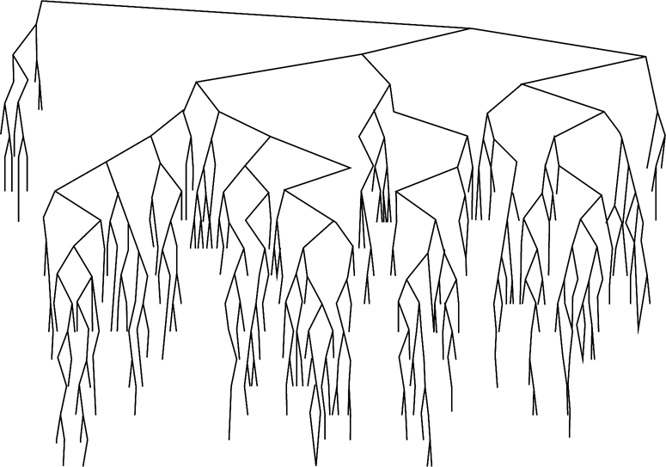
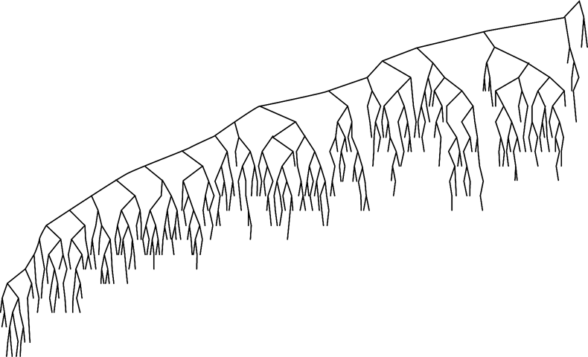
BST: Deletion Bias
After large number of alternating insertions and deletions
Why this bias? How do you fix it?

